Slide 1
Embedding and Sketching
Non-normed spaces
Alexandr Andoni (MSR)

Slide 2
Embedding / Sketching
Definition: an embedding is a map f:M→H of a metric (M, d_{M}) into a host metric (H, ρ_{H}) such that for any x,y∈M:
  d_{M}(x,y) ≤ ρ_{H}(f(x), f(y)) ≤ D * d_{M}(x,y)
  where D is the distortion (approximation) of the embedding f.
Embeddings come in all shapes and colors:
  Source/host spaces M,H
  Distortion D
  Can be randomized: ρ_{H}(f(x), f(y)) ≈ d_{M}(x,y) with 1-δ probability
  Can be non-oblivious: given set S⊂M, compute f(x) (depends on entire S)
  Time to compute f(x)
  …
Types of embeddings:
  From a norm (ℓ₁) into another norm (ℓ∞)
  From norm to the same norm but of lower dimension (dimension reduction)
  From non-norms (Earth-Mover Distance, edit distance) into a norm (ℓ₁)
  From given finite metric (shortest path on a planar graph) into a norm (ℓ₁)
  …

Slide 3


Earth-Mover Distance
Definition:
  Given two sets A, B of points in a metric space
  EMD(A,B) = min cost bipartite matching between A and B
Which metric space?
  Can be plane, ℓ₂, ℓ₁…
Applications in image vision

Slide 4
Planar EMD
Consider EMD on grid [Δ]x[Δ], and sets of size s
What do we want to do?
  Compute EMD between two sets (min-cost bi-chromatic matching)
  Closest pair, nearest neighbor search, etc
What can we do?
  Exact computation: O(s^{2+ε}) time [AES95]
  No non-trivial nearest neighbor search (exact)
In fact, at least as hard as Hamming space of dimension Θ(Δ²)

Slide 5
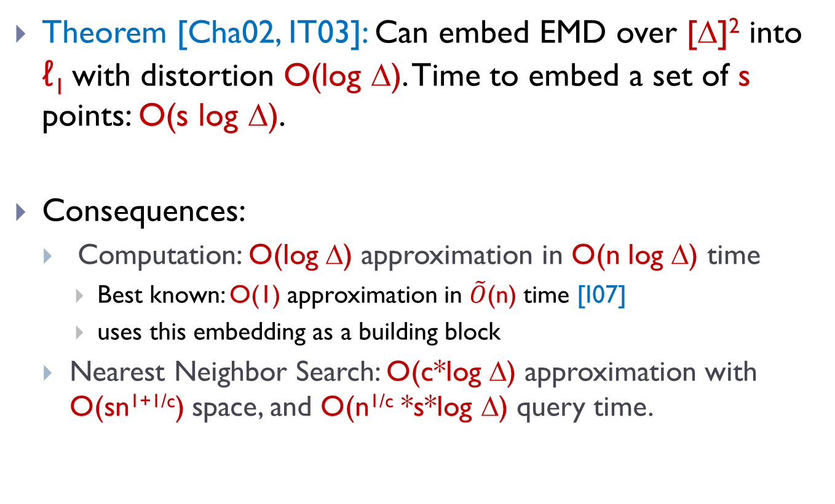
Approximate algorithms via embedding
Theorem [Cha02, IT03]: Can embed EMD over [Δ]² into ℓ₁ with distortion O(log Δ). Time to embed a set of s points: O(s log Δ).
Consequences:
  Computation: O(log Δ) approximation in O(n log Δ) time
    Best known: O(1) approximation in $\tilde{O}$(n) time [I07]
    uses this embedding as a building block
  Nearest Neighbor Search: O(c*log Δ) approximation with O(sn^{1+1/c}) space, and O(n^{1/c} *s*log Δ) query time.

Slide 6
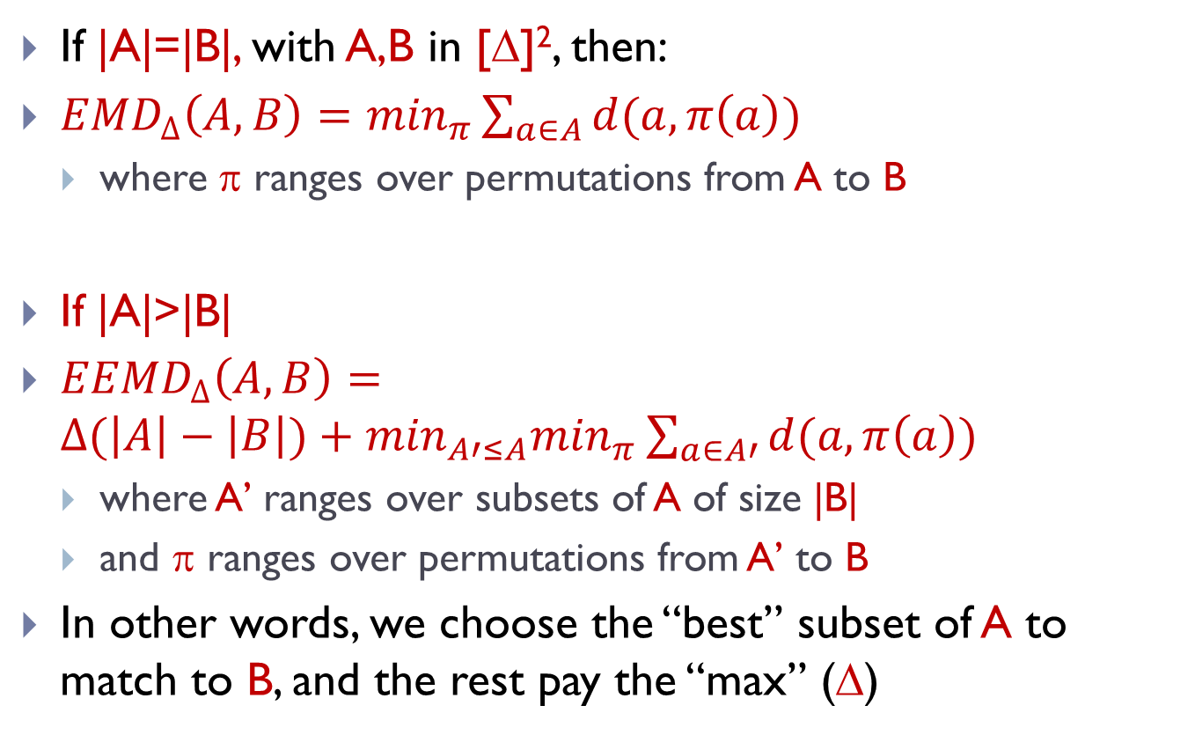
Couple definitions
If |A|=|B|, with A,B in [Δ]², then:
${EMD}_{∆}\left(A,B\right)=\min_{π}\sum_{a∈A}{d(a,π\left(a\right))}$
  where π ranges over permutations from A to B
If |A|>|B|
${EEMD}_{∆}\left(A,B\right)={∆(\left|A\right|−\left|B\right|)+min}_{A′≤A}\min_{π}\sum_{a∈A′}{d(a,π\left(a\right))}$
  where A’ ranges over subsets of A of size |B|
  and π ranges over permutations from A’ to B
In other words, we choose the “best” subset of A to match to B, and the rest pay the “max” (Δ)

Slide 7
EMD over small grid
Suppose Δ=3
How to embed A,B in [3]² into ℓ₁ with distortion O(1) ?
f(A) has nine coordinates, counting # points in each joint
  f(A)=(2,1,1,0,0,0,1,0,0)
  f(B)=(1,1,0,0,2,0,0,0,1)

Slide 8
Embedding EMD([Δ]²) into ℓ₁
Sets of size s in [1…Δ]x[1…Δ] box
Embedding of set A:
  impose randomly-shifted
  grid
  Each grid cell gives
  a coordinate:
  f (A)_{c}=#points in the cell c
  Subpartition the grid
  recursively, and assign
  new coordinates for each
  new cell (on all levels)
0
0
0
0
0
2
1
1
1
2
2
2
0
1
2
0
0
1
0
0

Slide 9
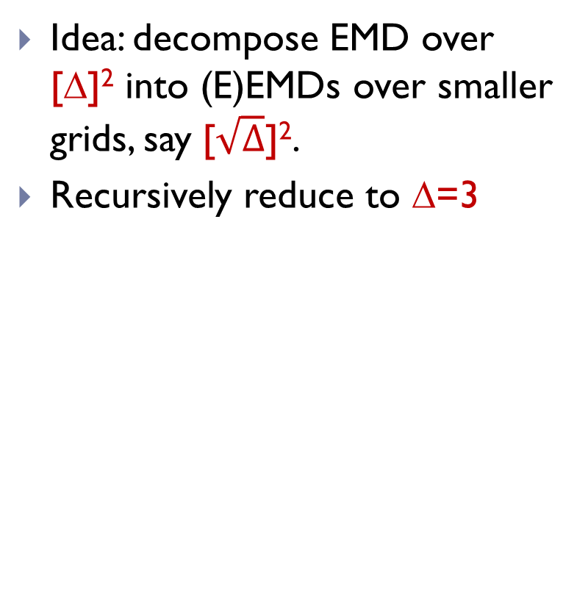
Main Approach
Idea: decompose EMD over [Δ]² into (E)EMDs over smaller grids, say [$\sqrt{∆}$]².
Recursively reduce to Δ=3
≈
+

Slide 10
Decomposition Lemma [I07]
For randomly-shifted cut-grid G of side length k, we have:
  EEMD_{Δ}(A,B) ≤ EEMD_{k}(A₁, B₁) + EEMD_{k}(A₂,B₂)+…
  + k*EEMD_{Δ/k}(A_{G}, B_{G})
  3*EEMD_{Δ}(A,B) ≥ Ε[ EEMD_{k}(A₁, B₁) + EEMD_{k}(A₂,B₂)+… ]
  EEMD_{Δ}(A,B) ≥ Ε[ k*EEMD_{Δ/k}(A_{G}, B_{G}) ]
The main embedding will
follow by applying the lemma
recursively to (A_{G},B_{G})
k
Δ/k

Slide 11
Proof of Decomposition Lemma: Part 1
For a randomly-shifted cut-grid G of side length k, we have:
  EEMD_{Δ}(A,B) ≤ EEMD_{k}(A₁, B₁) + EEMD_{k}(A₂,B₂)+…
  + k*EEMD_{Δ/k}(A_{G}, B_{G})
Extract a matching π from the matchings on right-hand side
For each a∈A, with a∈A_{i}, it is either:
  matched in EEMD(A_{i},B_{i}) to some b∈B_{i}
  or a∈A_{i}\B_{i}, and it is matched
  in EEMD(A_{G},B_{G}) to some b∈B_{j}
Match cost of a (2nd case):
  Move a to center (Δ)
    paid by EEMD(A_{i},B_{i})
  Move from cell i to cell j
    paid by EEMD(A_{G},B_{G})
Extra points |A-B| pay k*Δ/k=Δ
k
Δ/k

Slide 12
Proof of Decomposition Lemma: Part 2 & 3
For a randomly-shifted cut-grid G of side length k, we have:
  3*EEMD_{Δ}(A,B) ≥ Ε[ EEMD_{k}(A₁, B₁) + EEMD_{k}(A₂,B₂)+… ]
  EEMD_{Δ}(A,B) ≥ Ε[ k*EEMD_{Δ/k}(A_{G}, B_{G}) ]
Fix a matching π minimizing EEMD_{Δ}(A,B)
  Will construct matchings for each EEMD on RHS
Uncut pairs (a,b) are matched in respective (A_{i},B_{i})
Cut pairs (a,b) are matched
  in (A_{G},B_{G})
  and remain unmatched in their
  mini-grids

Slide 13
Part 2: 3*EEMD_{Δ}(A,B) ≥ Ε[ ∑_{i} EEMD_{k}(A_{i}, B_{i})]
Uncut pairs (a,b) are matched in respective (A_{i},B_{i})
  Contribute a total ≤ EEMD _{Δ}(A,B)
Consider a cut pair (a,b) at distance a-b=(d_{x},d_{y})
  Contribute ≤ 2k to ∑_{i} EEMD_{k}(A_{i}, B_{i})
  Pr[(a,b) cut] = 1-(1-d_{x}/k)(1-d_{y}/k) ≤ (d_{x}+d_{y})/k
  Expected contribution ≤ Pr[(a,b) cut] *2k = 2(d_{x}+d_{y})=2||a-b||₁
  In total, contribute 2*EEMD _{Δ}(A,B)
k
d_{x}

Slide 14
  Part 3: EEMD_{Δ}(A,B) ≥ Ε[ k*EEMD_{Δ/k}(A_{G}, B_{G}) ]
All uncut pairs contribute zero to k*EEMD_{Δ/k}(A_{G}, B_{G})
For a cut pair at distance a-b=(d_{x},d_{y})
  if d_{x}= xk+r_{x}, and d_{y}= yk+r_{y}, then
  expected cost ≤ (x+r_{x}/k) * k + (y+r_{y}/k) * k = d_{x}+d_{y} = ||a-b||₁
Total expected cost ≤ EEMD_{Δ}(A,B)
k
k
k
d_{x}

Slide 15
Embedding into ℓ₁ using the
Decomposition Lemma
For randomly-shifted cut-grid G of side length k, we have:
  EEMD_{Δ}(A,B) ≤ ∑_{i} EEMD_{k}(A_{i}, B_{i}) + k*EEMD_{Δ/k}(A_{G}, B_{G})
  3*EEMD_{Δ}(A,B) ≥ Ε[ ∑_{i} EEMD_{k}(A_{i}, B_{i}) ]
  EEMD_{Δ}(A,B) ≥ Ε[ k*EEMD_{Δ/k}(A_{G}, B_{G}) ]
To embed into ℓ₁, we applying it recursively for k=3
  Choose randomly-shifted cut-grid G₁ on [Δ]²
  Obtain many grids [3]², and a big grid [Δ/3]²
  Then choose randomly-shifted cut-grid G₂ on [Δ/3]²
  Obtain more grids [3]², and another big grid [Δ/3²]²
  Then choose randomly-shifted cut-grid G₃ on [Δ/9]²
  …
Then, embed each of the small grids [3]² into ℓ₁, using O(1) distortion embedding, and concatenate the embeddings

Slide 16
Proving recursion works
Embedding does not contract distances:
  EEMD_{Δ}(A,B) ≤
  ∑_{i} EEMD_{k}(A_{i}, B_{i}) + k*EEMD_{Δ/k}(A_{G1}, B_{G1}) ≤
  ∑_{i} EEMD_{k}(A_{i}, B_{i}) + k∑_{i} EEMD_{k}(A_{G1,i}, B_{G1,i})+k*EEMD_{Δ/k}(A_{G2}, B_{G2}) ≤ …
Embedding distorts distances by O(log Δ), in expectation:
  (3log_{k}Δ) * EEMD_{Δ}(A,B) ≥
  3* EEMD_{Δ}(A, B) + (3log_{k}Δ/k)*EEMD_{Δ}(A, B) ≥
  Ε[ ∑_{i} EEMD_{k}(A_{i}, B_{i}) + (3log_{k}Δ/k)*k*EEMD_{Δ/k}(A_{G1}, B_{G1}) ] ≥
  …
By Markov’s, it’s O(log Δ) distortion with 90% probability

Slide 17
Final theorem
Theorem: can embed EMD over [Δ]² into ℓ₁ with O(log Δ) distortion.
  Dimension required: O(Δ²), but a set A of size s maps to a vector that has only O(s*log Δ) non-zero coordinates.
  Time: can compute in O(s*log Δ)
  Randomized: does not contract, but large distortortion happens with <10%
Applications:
  Can compute EMD(A,B) in time O(s*log Δ)
  NNS: O(c*log Δ) approximation, with O(n^{1+1/c}*s) space, O(n^{1/c} *s*log Δ) query time.

Slide 18
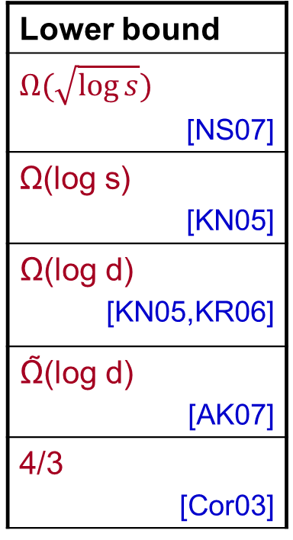
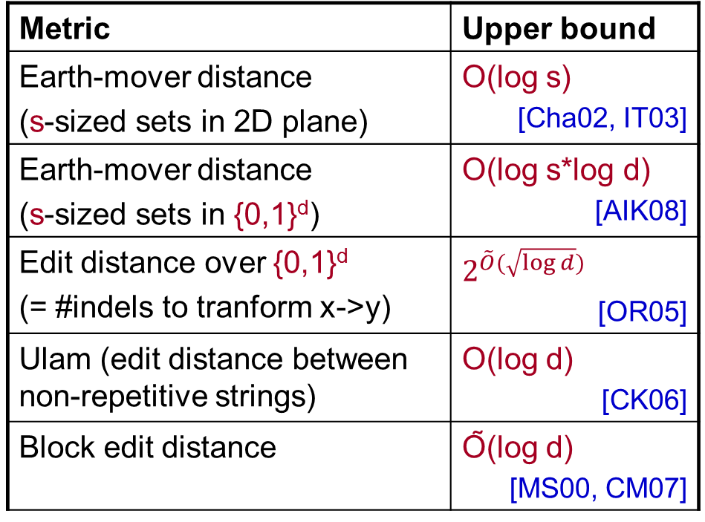
Embeddings of various metrics
Embeddings into ℓ₁
Metric | Upper bound
Earth-mover distance (s-sized sets in 2D plane) | O(log s) [Cha02, IT03]
Earth-mover distance (s-sized sets in {0,1}^{d}) | O(log s*log d) [AIK08]
Edit distance over {0,1}^{d} (= #indels to tranform x->y) | $$2^{\tilde{O}(\sqrt{\log{d}})}$$ [OR05]
Ulam (edit distance between non-repetitive strings) | O(log d) [CK06]
Block edit distance | Õ(log d) [MS00, CM07]
Lower bound
$$Ω(\sqrt{\log{s}})$$ [NS07]
Ω(log s) [KN05]
Ω(log d) [KN05,KR06]
Ω̃(log d) [AK07]
4/3 [Cor03]

Slide 19
Curse of non-embeddability into ℓ₁ ?
ℓ₁ natural target for many metrics, and have algorithms
Will see two example of “going beyond ℓ₁”
  Sketching for EMD
  Embedding of Ulam metric into product spaces
Enable (weaker) results for NNS

Slide 20
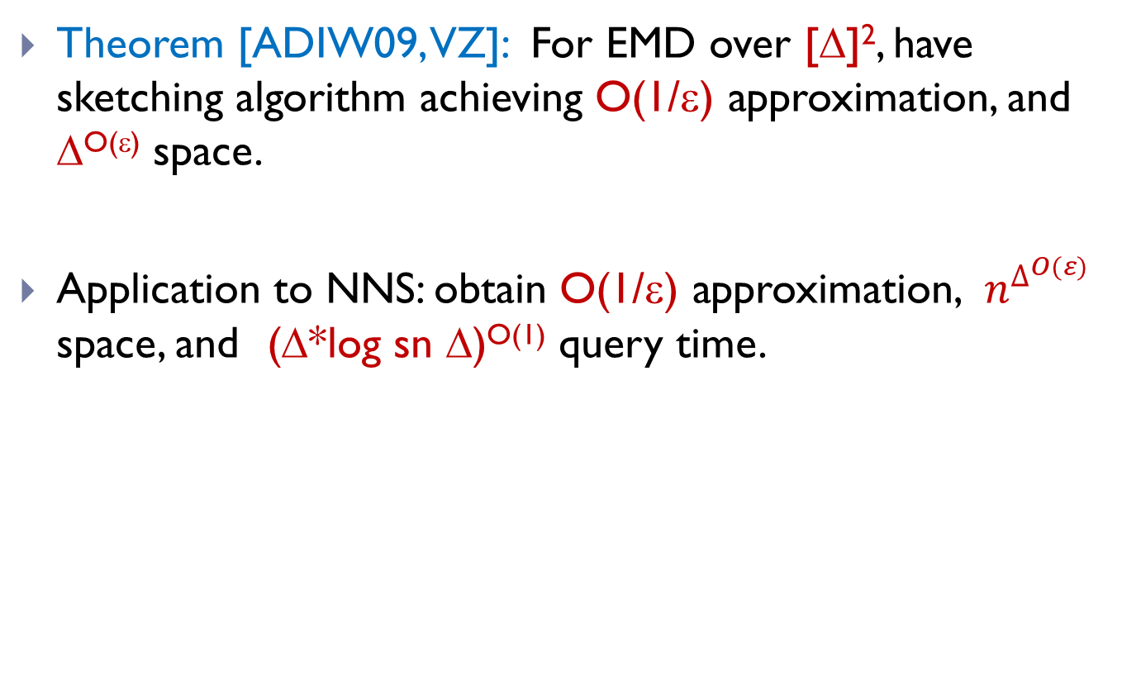
Sketching EMD
Theorem [ADIW09, VZ]: For EMD over [Δ]², have sketching algorithm achieving O(1/ε) approximation, and Δ^{O(ε)} space.
Application to NNS: obtain O(1/ε) approximation, $n^{∆^{O(ε)}}$ space, and (Δ*log sn Δ)^{O(1)} query time.

Slide 21
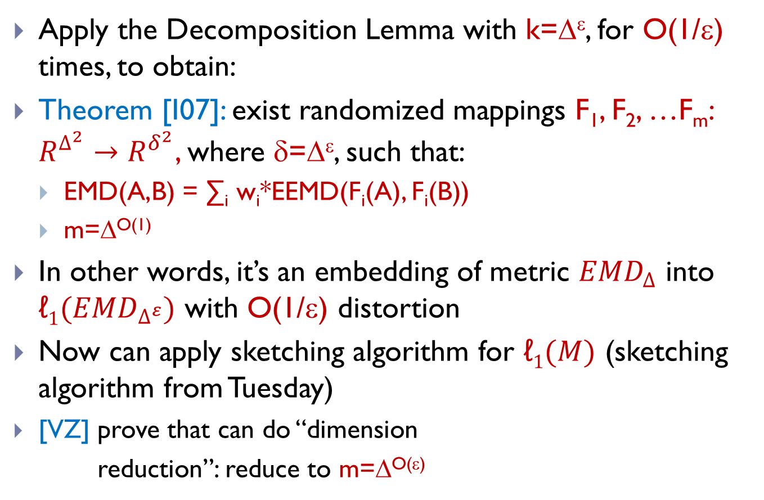
How to obtain a sketch for EMD
Apply the Decomposition Lemma with k=Δ^{ε}, for O(1/ε) times, to obtain:
Theorem [I07]: exist randomized mappings F₁, F₂, …F_{m}: $R^{∆^{2}}→R^{δ^{2}}$, where δ=Δ^{ε}, such that:
  EMD(A,B) = ∑_{i} w_{i}*EEMD(F_{i}(A), F_{i}(B))
  m=Δ^{O(1)}
In other words, it’s an embedding of metric ${EMD}_{∆}$ into ${\text{ℓ}1(EMD}_{∆^{ε}})$ with O(1/ε) distortion
Now can apply sketching algorithm for $\text{ℓ}1(M)$ (sketching algorithm from Tuesday)
  [VZ] prove that can do “dimension
  reduction”: reduce to m=Δ^{O(ε)}

Slide 22
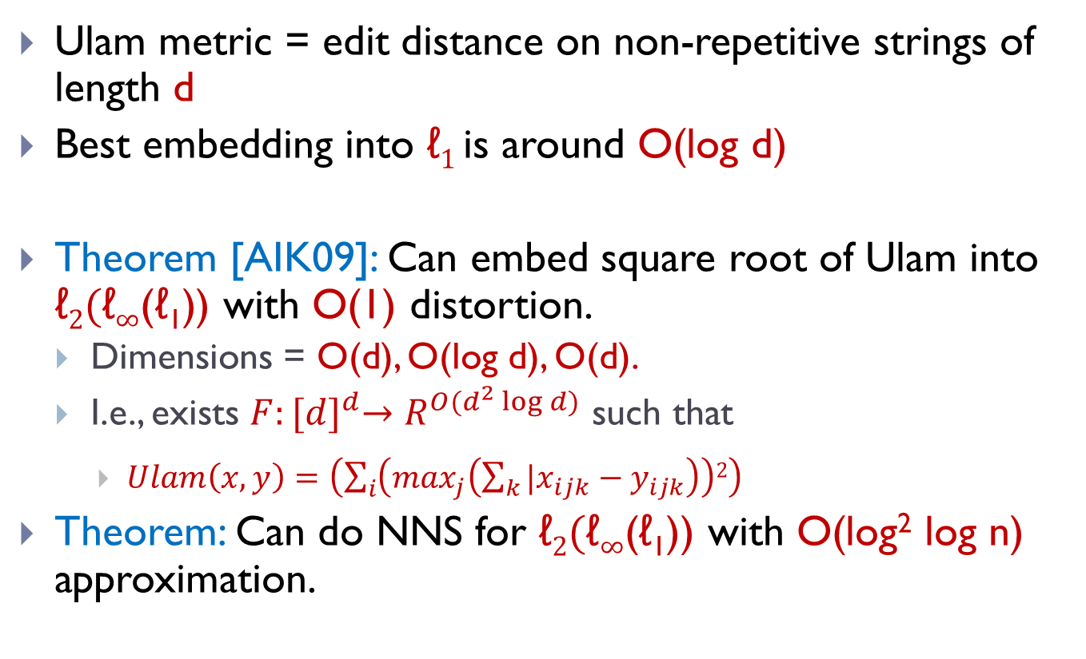
Ulam metric
Ulam metric = edit distance on non-repetitive strings of length d
Best embedding into $\text{ℓ}1$is around O(log d)
Theorem [AIK09]: Can embed square root of Ulam into $\text{ℓ}2\text{(}\text{ℓ}∞\text{(}\text{ℓ}\text{1}\text{))}$ with O(1) distortion.
  Dimensions = O(d), O(log d), O(d).
  I.e., exists $F:{[d]}^{d}→R^{O(d^{2}\log{d)}}$ such that
    $Ulam\left(x,y\right)={\left(\sum_{i}{\left(\max_{j}\left(\sum_{k}{|x_{ijk}−y_{ijk}}\right)\right)2}\right)}^{}$
Theorem: Can do NNS for $\text{ℓ}2\text{(}\text{ℓ}∞\text{(ℓ}\text{1}\text{))}$ with O(log² log n) approximation.
ED(1234567,
7123456) = 2

Slide 23


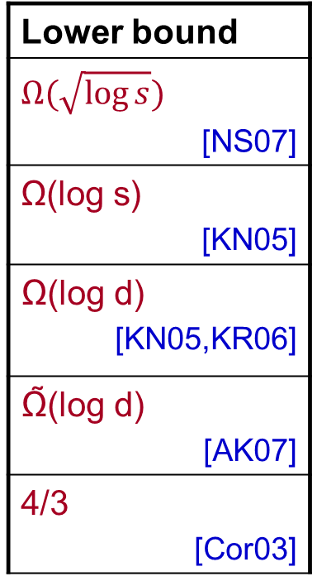
Some Open Questions on non-normed metrics
Metric | Upper bound
Earth-mover distance (s-sized sets in 2D plane) | O(log s) [Cha02, IT03]
Earth-mover distance (s-sized sets in {0,1}^{d}) | O(log s*log d) [AIK08]
Edit distance over {0,1}^{d} (= #indels to tranform x->y) | $$2^{\tilde{O}(\sqrt{\log{d}})}$$ [OR05]
Ulam (edit distance between non-repetitive strings) | O(log d) [CK06]
Block edit distance | Õ(log d) [MS00, CM07]
Lower bound
$$Ω(\sqrt{\log{s}})$$ [NS07]
Ω(log s) [KN05]
Ω(log d) [KN05,KR06]
Ω̃(log d) [AK07]
4/3 [Cor03]
Shift metric: $sh\left(x,y\right)=\min_{j}H(x,σ^{j}\left(y\right))$

Slide 24
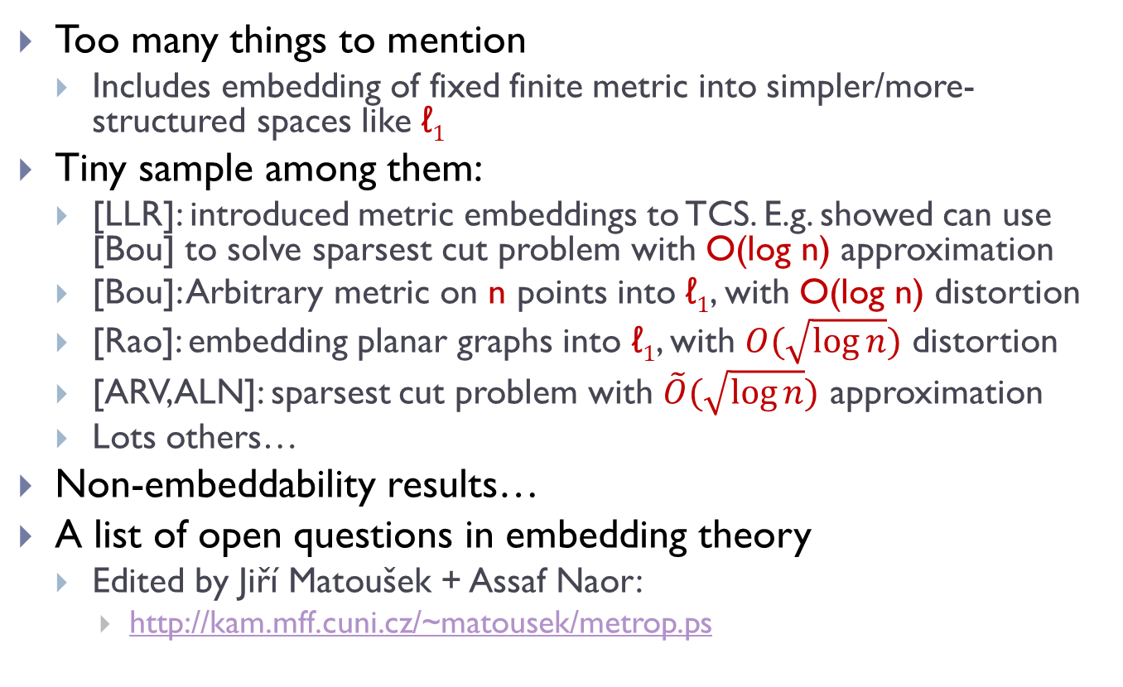
What I didn’t talk about:
Too many things to mention
  Includes embedding of fixed finite metric into simpler/more-structured spaces like $\text{ℓ}1$
Tiny sample among them:
  [LLR]: introduced metric embeddings to TCS. E.g. showed can use [Bou] to solve sparsest cut problem with O(log n) approximation
  [Bou]: Arbitrary metric on n points into $\text{ℓ}1$, with O(log n) distortion
  [Rao]: embedding planar graphs into $\text{ℓ}1$, with $O(\sqrt{\log{n}})$ distortion
  [ARV,ALN]: sparsest cut problem with $\tilde{O}(\sqrt{\log{n}})$ approximation
  Lots others…
Non-embeddability results…
A list of open questions in embedding theory
  Edited by Jiří Matoušek + Assaf Naor:
    http://kam.mff.cuni.cz/~matousek/metrop.ps

Slide 25
Bibliography 1
[AES95] PK Agarwal, A. Efrat, M. Sharir. Vertical decomposition of shallow levels in 3-dimensional arrangements and its applications”. SoCG95. SICOMP 00.
[Cha02] M. Charikar. Similarity estimation techniques from rounding. STOC02
[IT03] P. Indyk, N. Thaper. Fast color image retrieval via embeddings. Workshop on Statistical and Computational Theories in Vision (ICCV) 2003.
[I07] P. Indyk. A near linear time constant factor approximation for euclidean bichromatic matching (cost). In SODA 07.
[ADIW09] A. Andoni, K. Do Ba, P. Indyk, D. Woodruff. Efficient sketches for Earth-Mover Distance, with applications. FOCS09
[VZ] E. Verbin, Q. Zhang. Rademacher-Sketch: A dimensionality-reducing embedding for sum-product norms, with an application to Earth-Mover Distance. Manuscript 2011.

Slide 26
Bibliography 2
[AIK08] A. Andoni, P. Indyk, R. Krauthgamer. Earth-mover distance over high-dimensional spaces. SODA08.
[OR05] R. Ostrovsky, Y. Rabani. Low distortion embedding for edit distance. STOC05. JACM 2007.
[CK06] M. Charikar, R. Krauthgamer. Embedding the Ulam metric into ell_1. ToC 2006.
[MS00] M. Muthukrishnan, C. Sahinalp. Approximate nearest neighbors and sequence comparison with block operations. STOC00
[CM07] G. Cormode, M. Muthukrishnan. The string edit distance matching problem with moves. TALG 2007. SODA02.
[NS07] A. Naor, G. Schechtman. Planar earthmover in not in L_1. FOCS06. SICOMP 2007.
[KN05] S. Khot, A. Naor. Nonembeddability theorems via Fourier analysis. Math. Ann. 2006. FOCS05
[KR06] R. Krauthgamer, Y. Rabani. Improved lower bounds for embeddings into L1. SODA06.
[AK07] A. Andoni, R. Krauthgamer. The computational hardness of estimating edit distance. FOCS07. SICOMP10.
[Cor03] G. Cormode. Sequence Distance Embeddings. PhD Thesis.
[AIK09] A. Andoni, P. Indyk, R. Krauthgamer. Overcoming the ell_1 non-embeddability barrier: algorithms for product metrics. SODA09

Slide 27
Bibliography 3
[LLR] N. Linial, E. London, Y. Rabinovich. The geometry of graphs and some of its algorithmic applications. FOCS94
[Bou] J. Bourgain. On Lipschitz embedding of finite metric spaces into Hilbert space. Israel J Math. 1985.
[Rao] S. Rao. Small distortion and volume preserving embeddings for planar and Euclidean metrics. SoCG 1999.
[ARV] S. Arora, S. Rao, U. Vazirani. Expander flows, geometric embeddings and graph partitioning. STOC04. JACM 2009.
[ALN] S. Arora, J. Lee, A. Naor. Euclidean distortion and sparsest cut. STOC05.

